Slide 1
State Estimator Model Performance Tracker
Cavalier Autonomous Racing

Slide 2
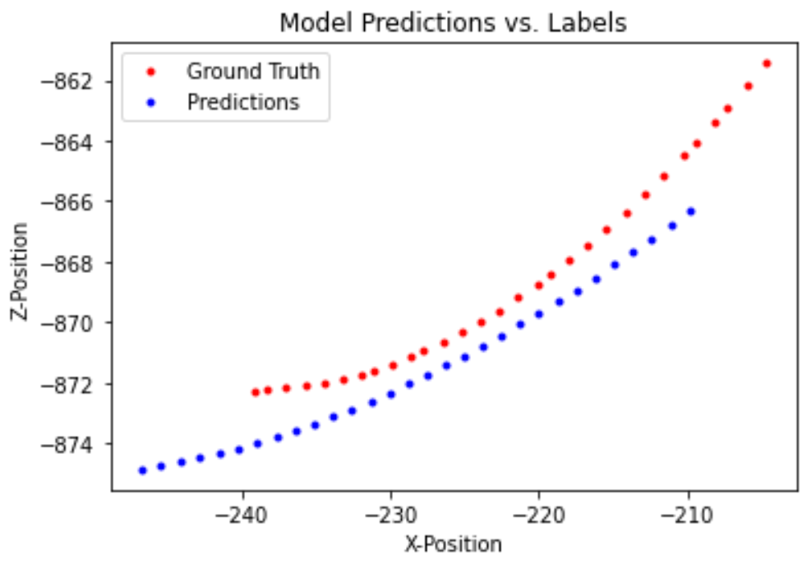
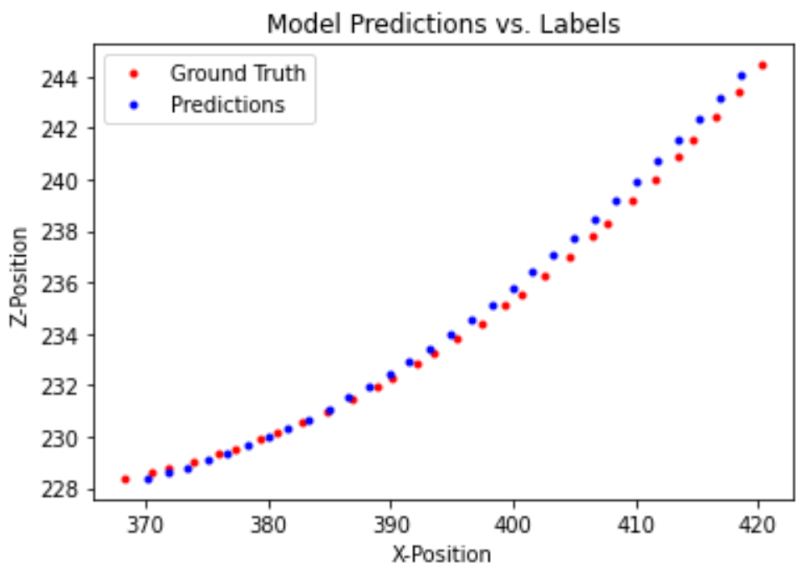
3 Layer LSTM, Waypoint Prediction, 30 timesteps
Training Set MSE: 31.298
Validation Set MSE: 31.569

